Slide 1
Final Project Microprocessors
Victor Herrera-Ramirez
Brendan Currie

Slide 2
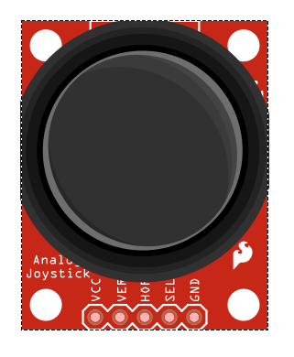

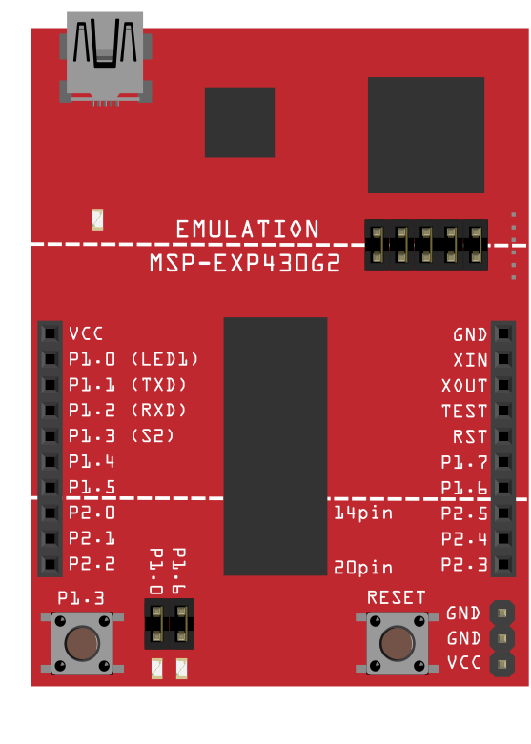
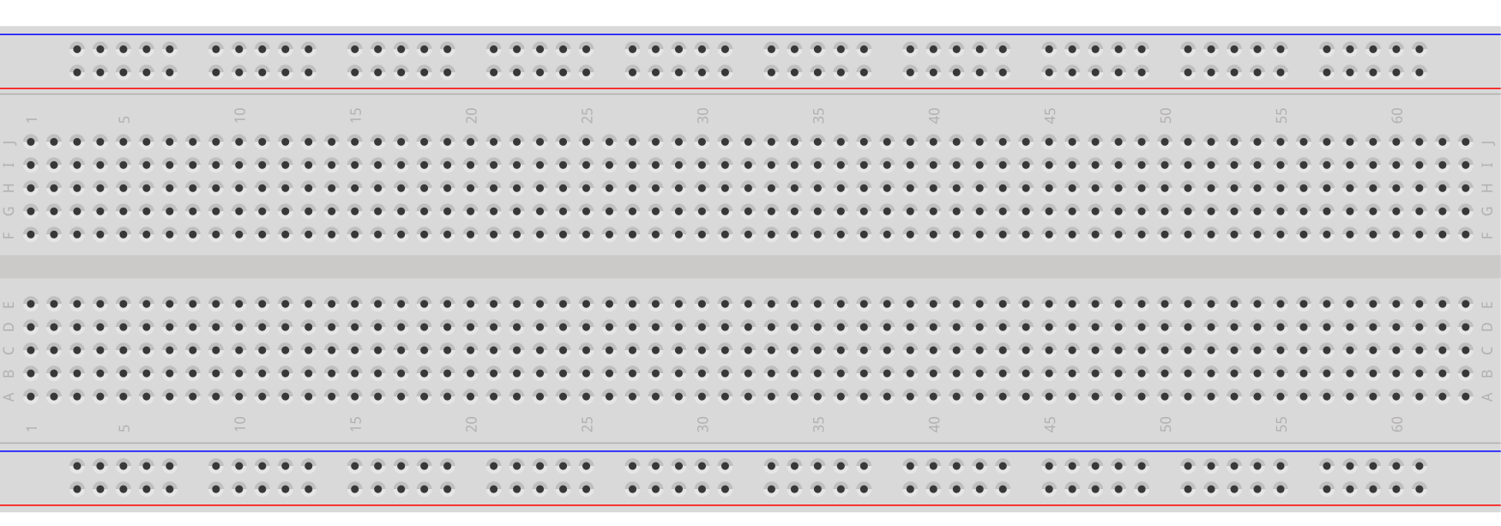
Specs
Parts:
1 Msp430G2553
9 LEDs for the matrix
2 LEDs for pass/fail condition of game
1 Joystick
19+ pieces of wire/jumper cable

Slide 3
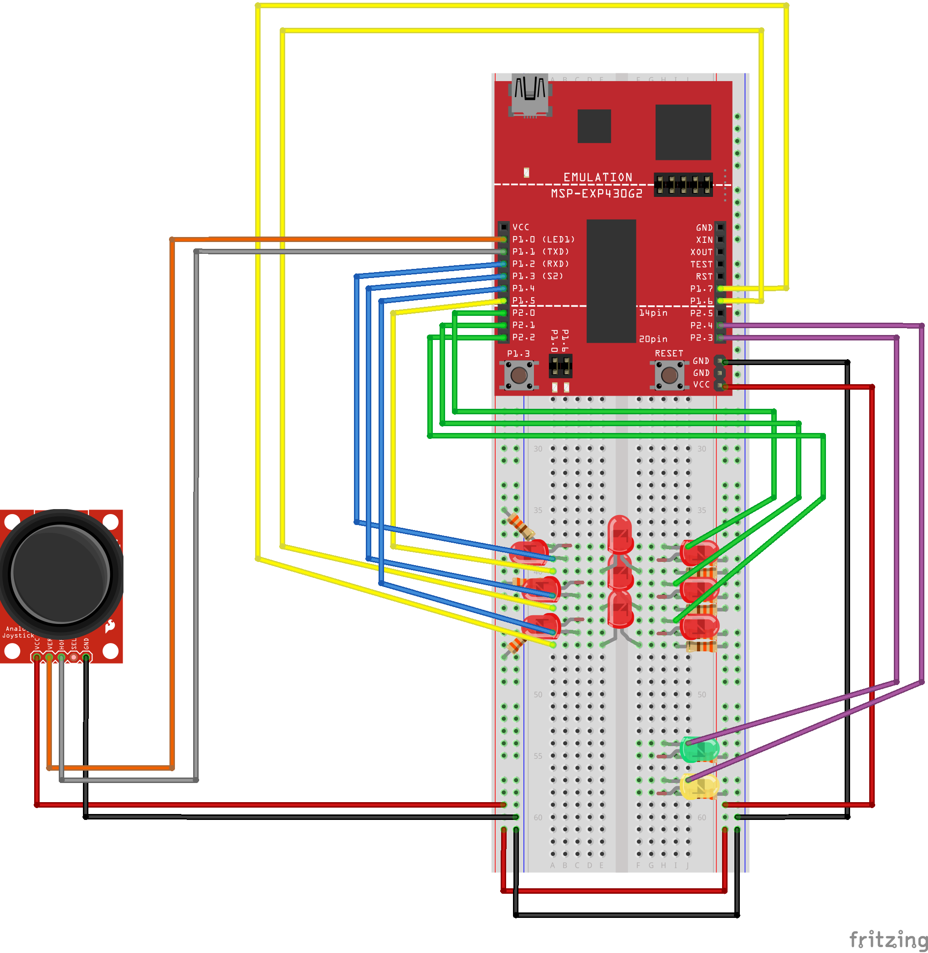
Schematic

Slide 4
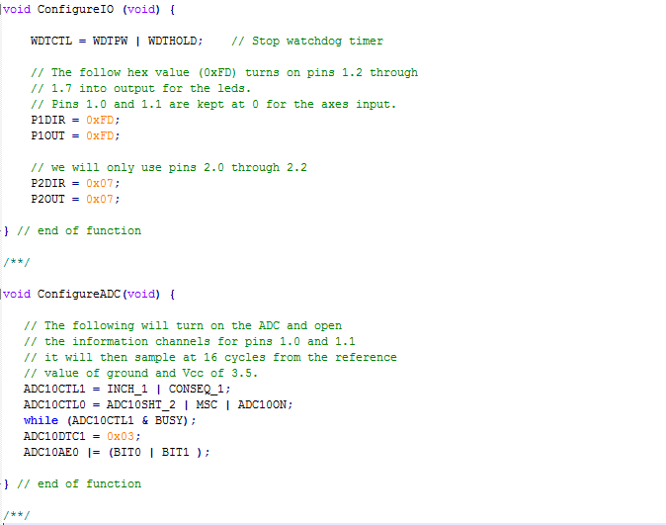
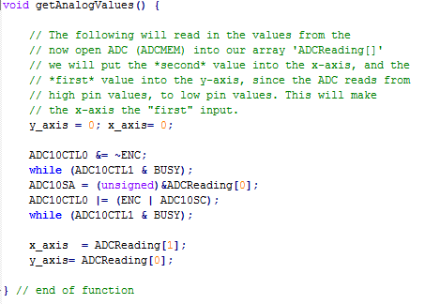
Code

Slide 5
Challenges and Solutions
Challenges
LCD Screen not function how it was intended.
LCD Screen was more difficult to work than initially intended.
ACD configuration was tedious and information from TI website was not helpful since we were using a different board than what was intended.
Solutions
Found that it was due to the incompatibility of the board.
We decided that we could not get the LCD screen to work with given time.
Using information from Lab 6 we were able to get a product we were happy with.

Slide 6

Video
https://www.youtube.com/watch?v=LLm35D2NqRQ

